Slide 1
Ms. Pac Man vs Ghost Team
Lecturer: Dr. Loo Chu Kiong
Student : Leow Jun Shou

Slide 2

1.Tree Search Strategy
2.Monte Carlo Strategy
3.Rule Based Strategy

Slide 3
2.Monte Carlo Strategy
-The First priority is to keep Ms. Pac-man alive.
-If there is any Ghost near by then must EVADE from Ghost, don't bother anything else
-If power pill is eaten, next check if any edible Ghost is present in the path.
-Eat pill with best direction even in junction or straight line.

Slide 4
3.Rule Based Strategy
-Go to pill is the first priority
-when the ghost is in observe area
-depend on the count of the ghost, activate different mode
-1 ghost nearby is greedy mode, go to eat pill even very close
-2 ghost nearby is standby mode, go to eat pill
-3 ghost nearby is defense mode, run
-4 ghost nearby is revenge mode, run for power pill

Slide 5
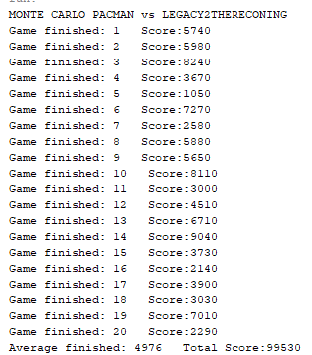
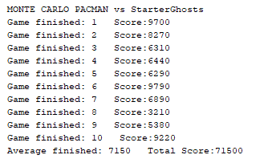
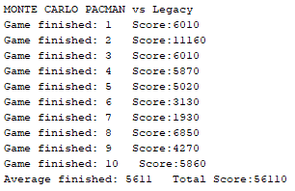
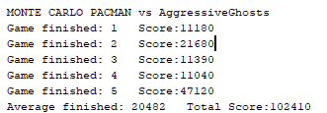


Tree Search Strategy’s Result

Slide 6
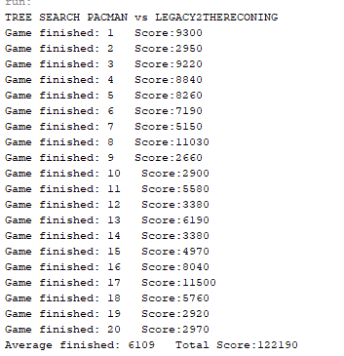
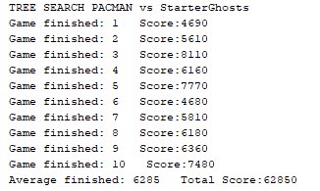
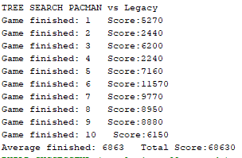
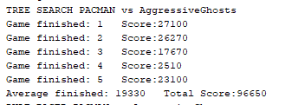


Monte Carlo Strategy‘s Result

Slide 7
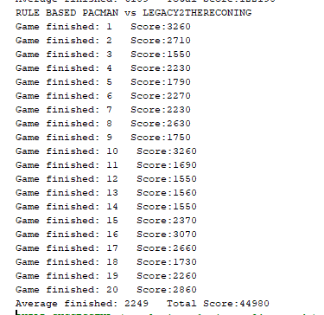
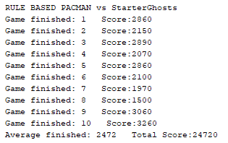
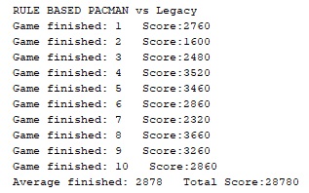
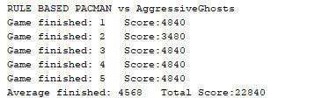
Rule Based’s Result

